Slide 1
Machine Learning Final Project (Fix Title slide)
Subtitle goes here

Slide 2
Title slide does not fit the colour scheme
Understanding customers’ opinions through
natural language processing
MSBA Machine Learning Project
Team 9 | Derek Huang, Aman Jiddewar, Mira Stefanova, Katie Wallis
8 April 2019

Slide 3
Today’s Agenda
We used Topic Modeling to understand the important features of the Amazon Kindle Fire
We do not currently have a demo
Problem Overview
Solution Demo
Data Preparation
Next Steps & Questions
Topic Modeling
Topic Interpretation & Senitments

Slide 4
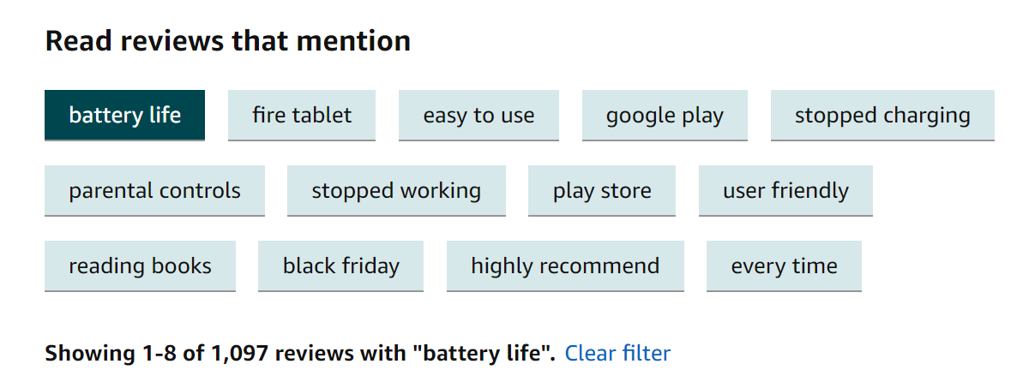
Filter Amazon Reviews by the Topic You’re Interested In
Fix all slide headers to the same font and align
For Amazon’s most popular products there are thousands of reviews; Customers need to filter through the noise.
Currently, Amazon uses 2-Grams to discover the most mentioned words in reviews
Some of the N-Grams aren’t great filters…
Instead, Amazon could use topic modeling to filter reviews!

Slide 5
We used Text Mining on Amazon Reviews to prepare the data for analysis
Filter Reviews for Kindle
Natural Language Processing
Sentiment Analysis with NLTK
Kindle Fire has 233 reviews
Average Review Rating: 3.95
Filtering done with AWS Athena
Reviews were tokenized
Stop-words removed
Words stemmed
Long words were removed
Extracted Positive, Negative and Neutral Sentiments
Used NLTK Dictionary
These are not complete and updated to latest process used

Slide 6
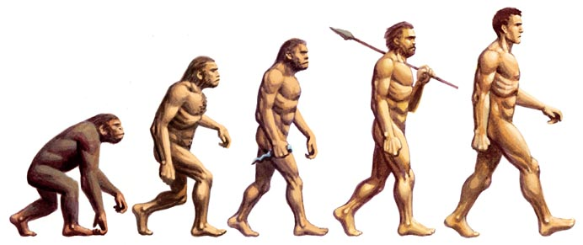
We compared side-by-side three different topic modelling approaches for the task of discovering underlaying topics
Latent Semantic Analysis
(LSA)
Probabilistic Latent Semantic Analysis
(PLSA)
Latent Dirichlet Allocation
(LDA)
TRAINING SPEED
TRAINING SPEED
TRAINING SPEED
90%
85%
70%
ACCURACY
ACCURACY
ACCURACY
60%
70%
85%
QUALITY DEPENDANT ON HAVING LARGE DATASET
QUALITY DEPENDANT ON HAVING LARGE DATASET
INTERPRETABILITY OF RESULTS
90%
80%
90%
Source: “Topic Modeling with LSA, PLSA, LDA & lda2Vec”, Joyce Xu, Medium.com

Slide 7
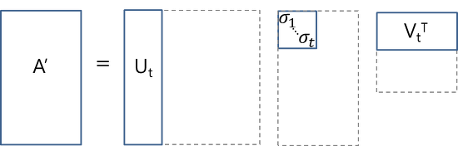
Core Idea
Take a matrix of what we have — documents and terms — and decompose it into a separate document-topic matrix and a topic-term matrix.
Main Positive Aspect
- Quick and efficient to use
Shortcomings
Lack of interpretable embeddings (we don’t know what the topics are, and the components may be arbitrarily positive/negative)
Need for really large set of documents and vocabulary to get accurate results
Less efficient representation
Python Package you can use
Latent Semantic Analysis
Could add sample results from our script
……
Source: “Topic Modeling with LSA, PLSA, LDA & lda2Vec”, Joyce Xu, Medium.com

Slide 8
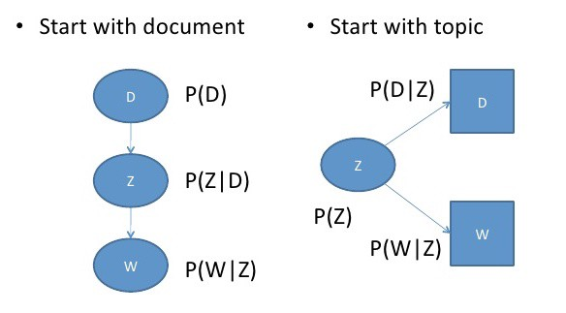
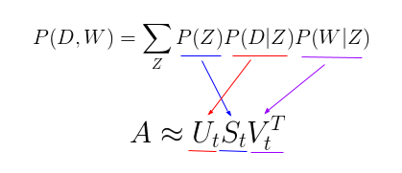
Core Idea
Find a probabilistic model with latent topics that can generate the data we observe in our document-term matrix
Main Positive Aspect
- More flexible model which adds a probabilistic treatment of topics and words on top of LSA
Shortcomings
Because we have no parameters to model P(D), we don’t know how to assign probabilities to new documents
The number of parameters for pLSA grows linearly with the number of documents we have, so it is prone to overfitting
Python Package you can use
Probabilistic Latent Semantic Analysis
Could add sample results from our script
……
Source: “Topic Modeling with LSA, PLSA, LDA & lda2Vec”, Joyce Xu, Medium.com

Slide 9
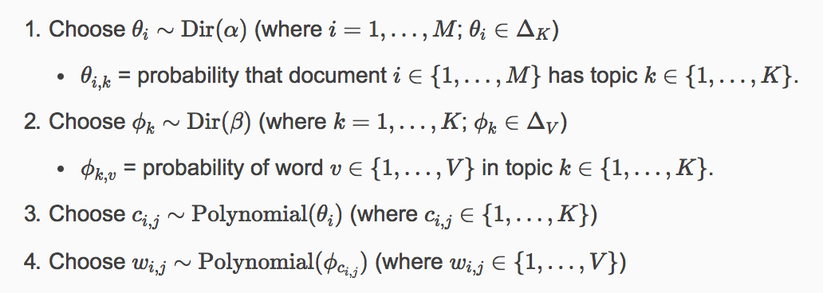
Core Idea
Bayesian version of pLSA which uses dirichlet priors for the document-topic and word-topic distributions.
* Dirichlet = “distribution over distributions”. Intuitive understanding: “Given this type of distribution, what are some actual probability distributions I am likely to see?”
Main Positive Aspects
Can generalize to new documents better than PLSA. Given a new document, we can obtain a vector representing its topic mixture.
The most popular and typically most effective topic modeling technique.
We can extract human-interpretable topics from a document corpus, where each topic is characterized by the words they are most strongly associated with.
Shortcomings
Still requires manual interpretation of the topics
Python Package you can use
Latent Dirichlet Allocation
Could add sample results from our script
Gensim
Gensim
Source: “Topic Modeling with LSA, PLSA, LDA & lda2Vec”, Joyce Xu, Medium.com

Slide 10
6 Topics were extracted
Need to re-run MBD’s script on sentiment analysis for these results
Need to re-run MBD’s script on sentiment analysis for these results
Topic 1
Topic 2
Frequency Mentioned
Topic 1
Average Positive Sentiment

Slide 11
Kindles Best and Worst Features
Need to re-run MBD’s script on sentiment analysis for these results
Matrix chart subtitle goes here
Most Positive
Least Positive
Key insights:
Topic 3
C
B
A
BatNequuntis vestibulum vitae ligula vitae orci euismod semper. Aenean in enim at nisl sollicitudin mollis pretium eu diam.
Suspendisse potenti. Ut sagittis accumsan pretium. Cras dictum finibus rhoncus. Cras elementum condimentum sem, venenatis porta nulla sagittis in.
Topic 1
Common
Frequency of Mentions
B
A
Topic 2
C
Uncommon
Average Positive Sentiment

Slide 12
Opportunities and challenges of this approach
Further Opportunities
…
…..
Challenges of this approach
Manual topic assignment across millions of products
Duis congue nisl vel magna ipsum et sollicitudin, efficitur aliquet mauris oso cursus. Nam suscipit sem sed eroson accumsan semper a a justo. Nunc vitae augue a erat volutpat lobortis vitae lorem tellus.

Slide 13
Questions

